Slide 1

Anatomy & Physiology Medical Center
Here is where your presentation begins

Slide 2
Contents of this template
You can delete this slide when you’re done editing the presentation
Fonts | To view this template correctly in PowerPoint, download and install the fonts we used
Used and alternative resources | An assortment of graphic resources that are suitable for use in this presentation
Thanks slide | You must keep it so that proper credits for our design are given
Colors | All the colors used in this presentation
Icons and infographic resources | These can be used in the template, and their size and color can be edited
Editable presentation theme | You can edit the master slides easily. For more info, click here
For more info:
Blog | Faqs

Slide 3
Name of the section
01

Slide 4
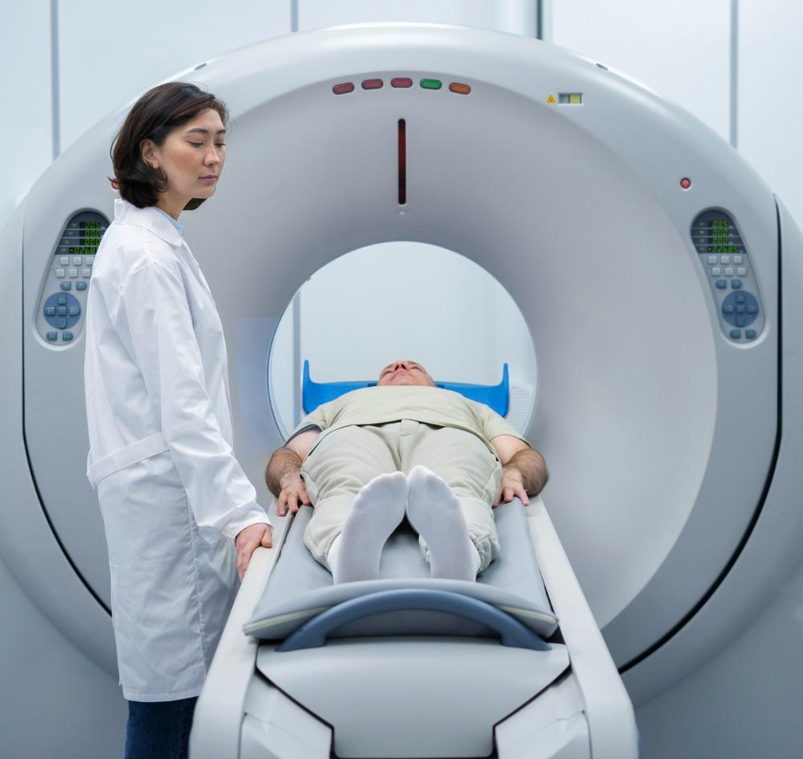
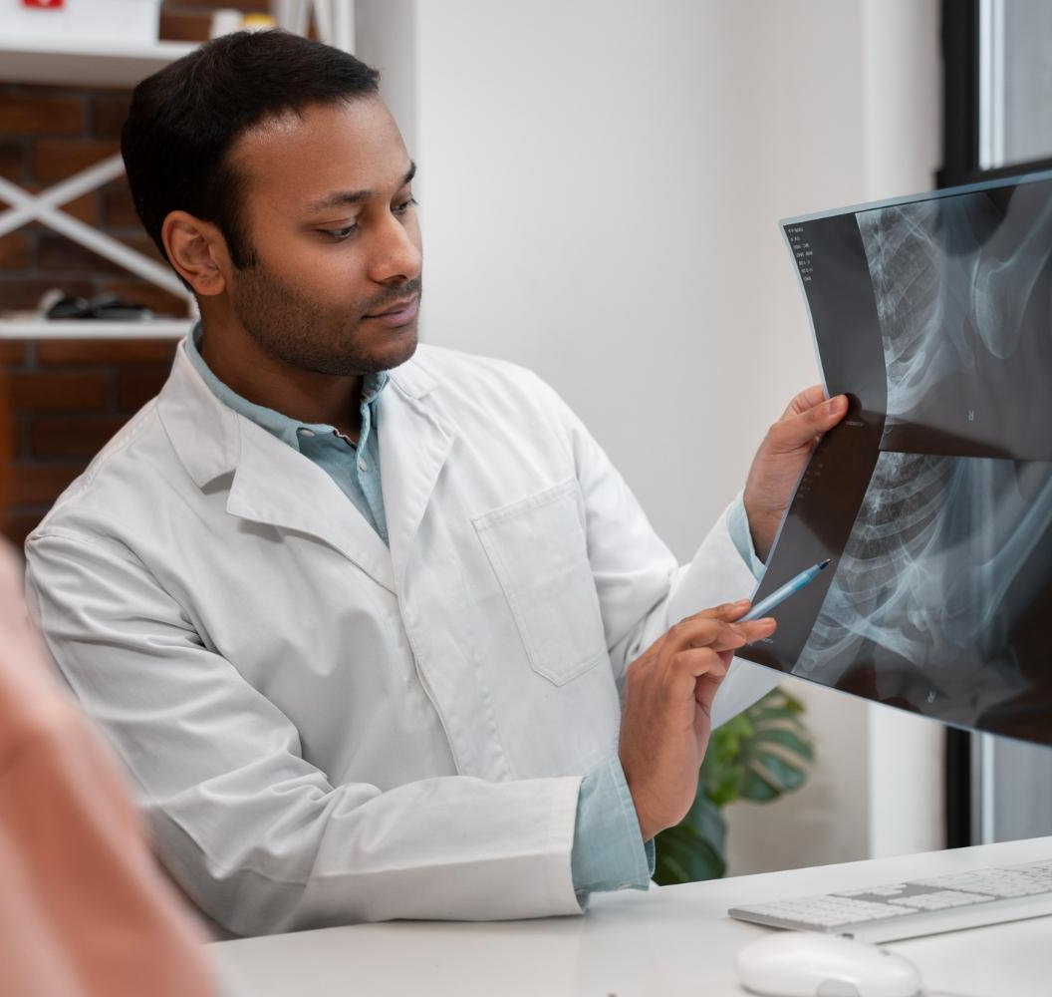
Our center
Do you know what helps you make your point clear? lists like this one:
They’re simple
You can organize your ideas clearly
You’ll never forget to buy milk!
You can replace the image. Just right-click on it and select “replace image”

Slide 5
Two ideas
Mercury
Venus
Mercury is the closest planet to the Sun and the smallest one in the Solar System—it’s only a bit larger than the Moon. This planet’s name has nothing to do with the liquid metal, since Mercury was named after the Roman messenger god
Venus has a beautiful name and is the second planet from the Sun. It’s terribly hot—even hotter than Mercury—and its atmosphere is extremely poisonous. It’s the second-brightest natural object in the night sky after the Moon

Slide 6

Three ideas
Jupiter
Jupiter is a gas giant and the biggest planet in the Solar System. It's the fourth-brightest object in the night sky and it was named after the Roman god of the skies
Venus
Venus has a beautiful name and is the second planet from the Sun. It’s terribly hot and its atmosphere is poisonous. It’s the second-brightest natural object in the night sky
Saturn
Saturn is a gas giant and has several rings. It’s composed mostly of hydrogen and helium. It’s the sixth planet from the Sun and was named after the Roman god of wealth

Slide 7
Four ideas
Mars
Venus
Despite being red, Mars is actually a cold place. It's full of iron oxide dust, which gives the planet its reddish cast, and it’s made of basalt
Venus has a beautiful name and is the second planet from the Sun. It’s terribly hot, even hotter than Mercury. It has a poisonous atmosphere
Jupiter
Saturn
Jupiter is a gas giant and the biggest planet in the Solar System. It's the fourth-brightest object in the night sky. It was named after a Roman god
Saturn is a gas giant and has several rings. It's composed mostly of hydrogen and helium. It’s the sixth planet from the Sun

Slide 8
Six ideas
Mars
Venus
Neptune
Despite being red, Mars is actually a cold place. It's full of iron oxide dust, which gives the planet its reddish cast
Venus has a beautiful name and is the second planet from the Sun. It’s terribly hot, even hotter than Mercury
Neptune is the farthest planet from the Sun. It's also the fourth-largest planet by diameter in the Solar System
Earth
Saturn
Jupiter
Earth is the third planet from the Sun and the only one that harbors life in the Solar System. We all live on this planet
Saturn is a gas giant and has rings. It's composed mostly of hydrogen and helium. It’s the sixth planet from the Sun
Jupiter is a gas giant and the biggest planet in the Solar System. It's the fourth-brightest object in the night sky

Slide 9
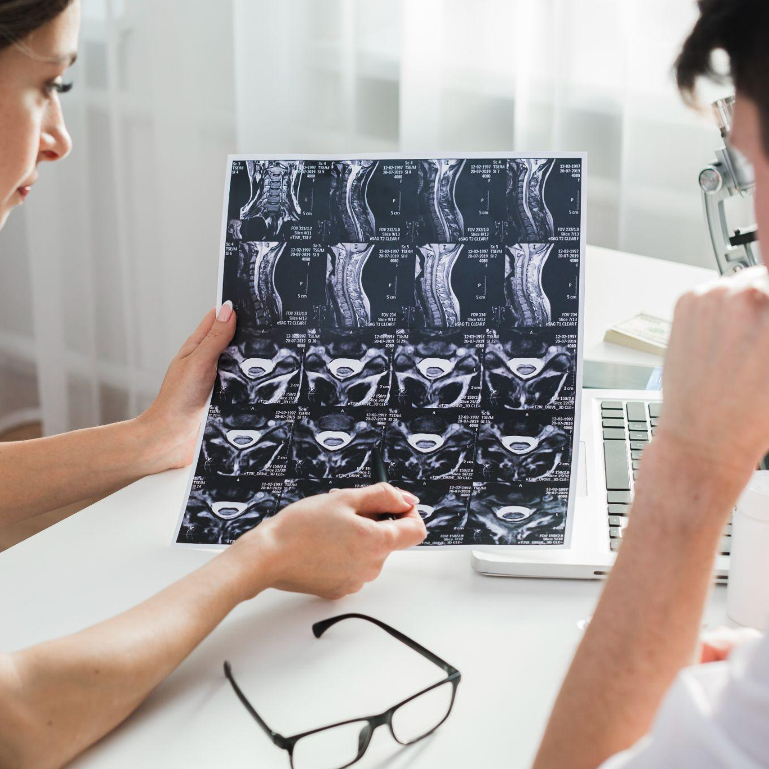
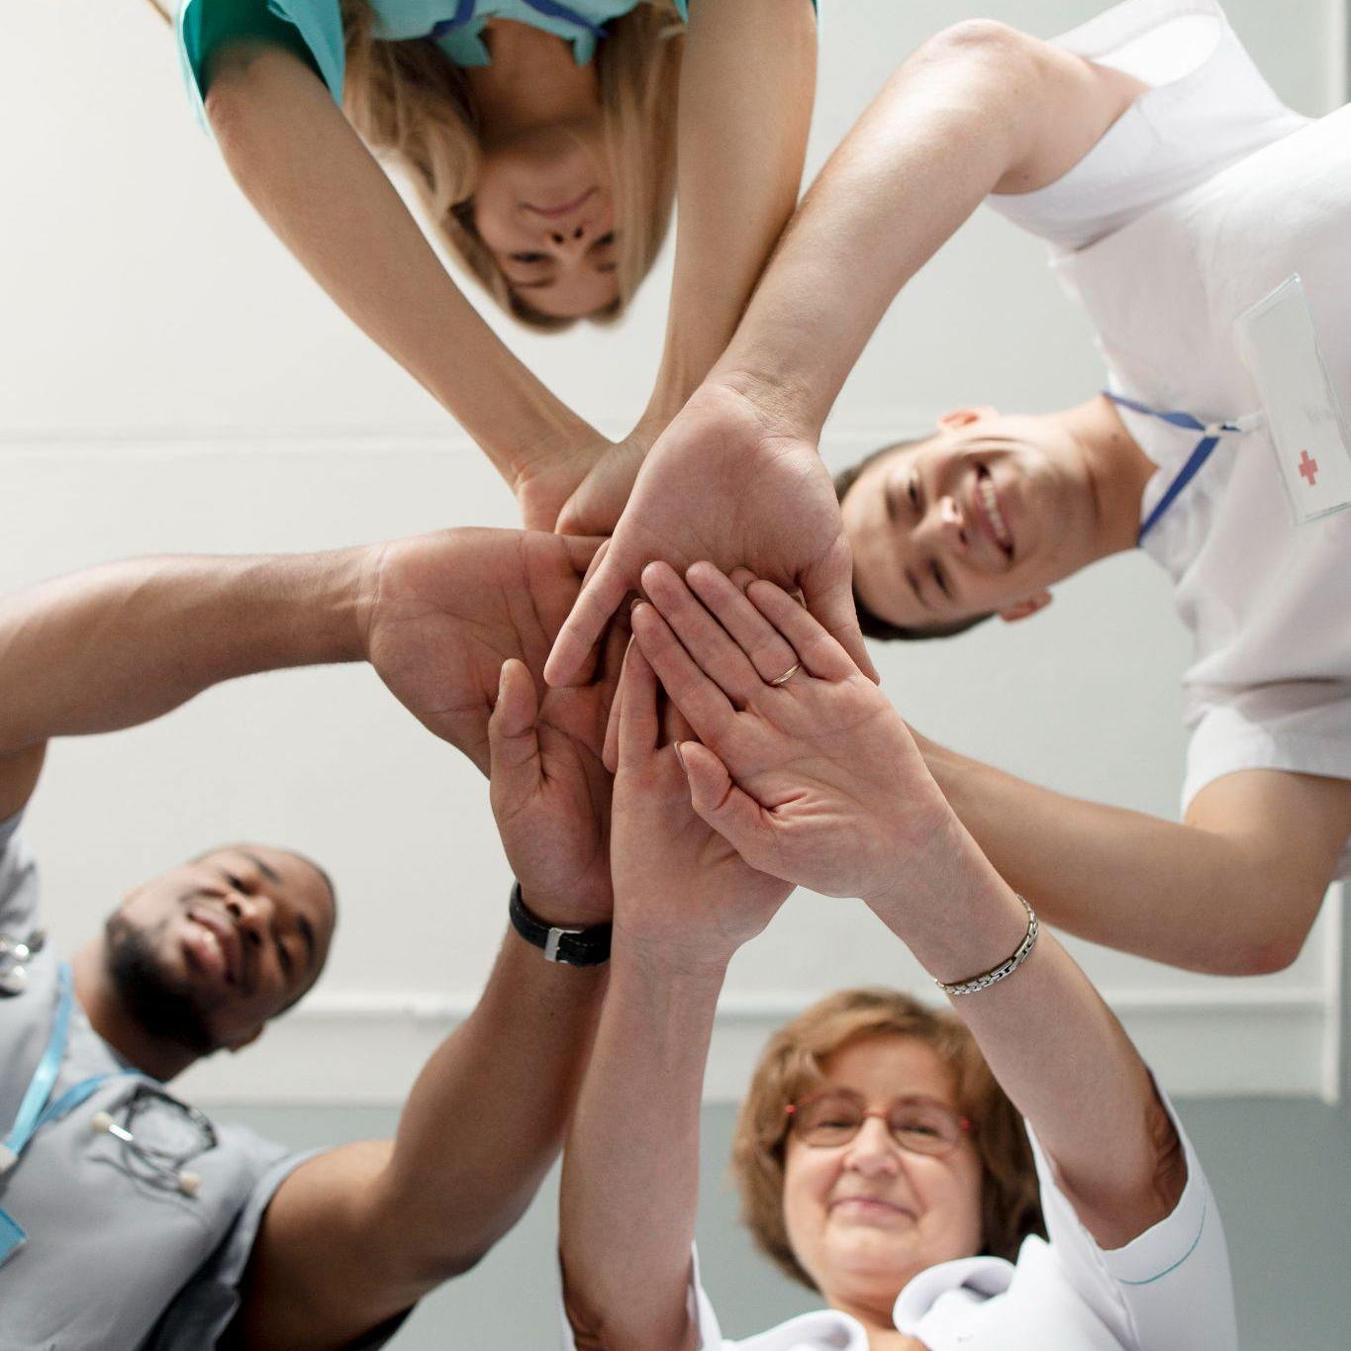
5,000
20,000
50,000
This is the number of transplants performed so far
This is the number of patients we had last month
This is the number of total visitors we had last month

Slide 10

95%
Mercury is the closest planet to the Sun and the smallest one in the Solar System—it’s only a bit larger than the Moon

Slide 11
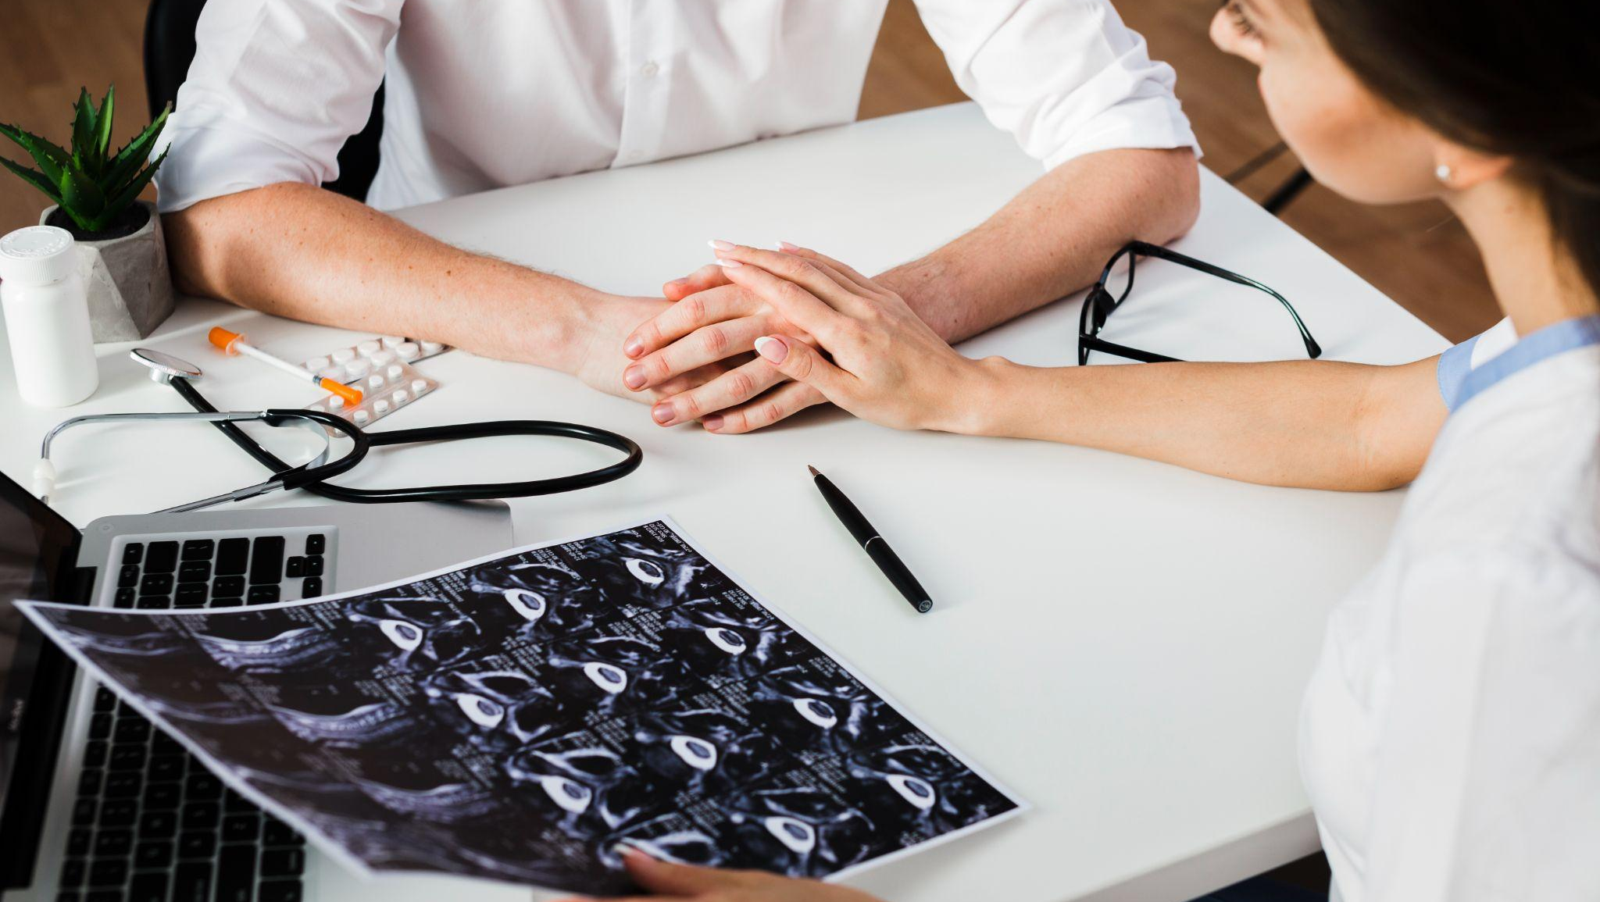
A picture is worth a thousand words

Slide 12
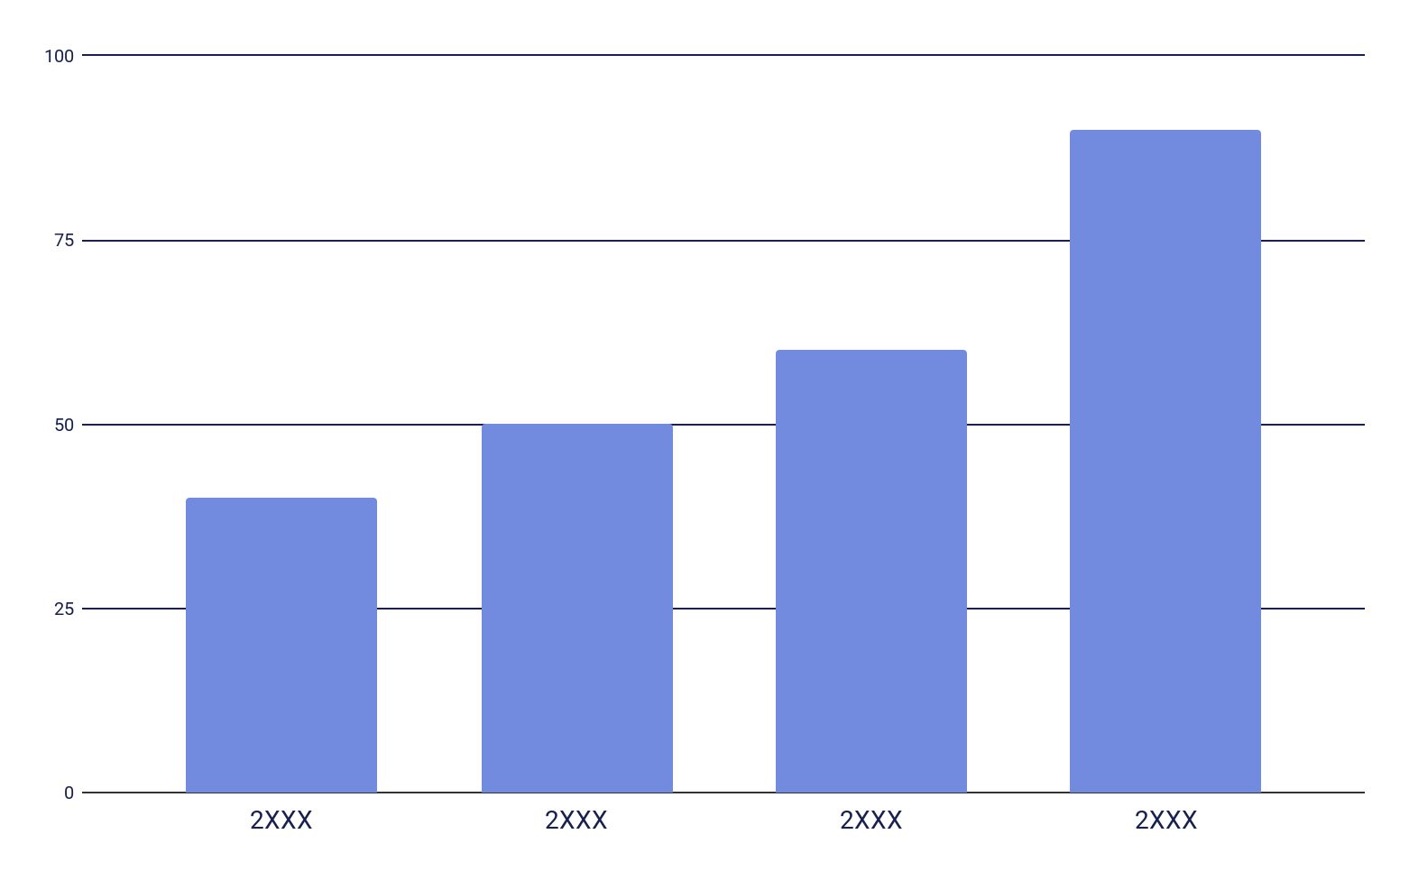
Our statistics
Understanding the numbers
Healthcare center statistics refer to the numerical data and metrics that provide insight into the performance, outcomes, and patient demographics of a healthcare facility. These statistics are used to inform decision-making and identify areas for improvement in the delivery of healthcare services
Follow the link in the graph to modify its data and then paste the new one here.

Slide 13

Our plans
Plan | Monthly premium | Deductible | Copayment | Coverage details
Basic plan | $100 | $500 | $20-$50 | Routine checkup Emergency room visit Hospitalization
Standard plan | $150 | $300 | $15-$40 | All of the above Specialist coverage Prescription drugs
Premium plan | $200 | $200 | $10-$30 | All of the above Maternity coverage Mental health coverage

Slide 14
Milestones reached
Mercury is very small
Venus is very hot
Earth has life
Mars is very cold
Jupiter is big
Saturn is a gas giant
Neptune is an ice giant
The Moon is a satellite

Slide 15
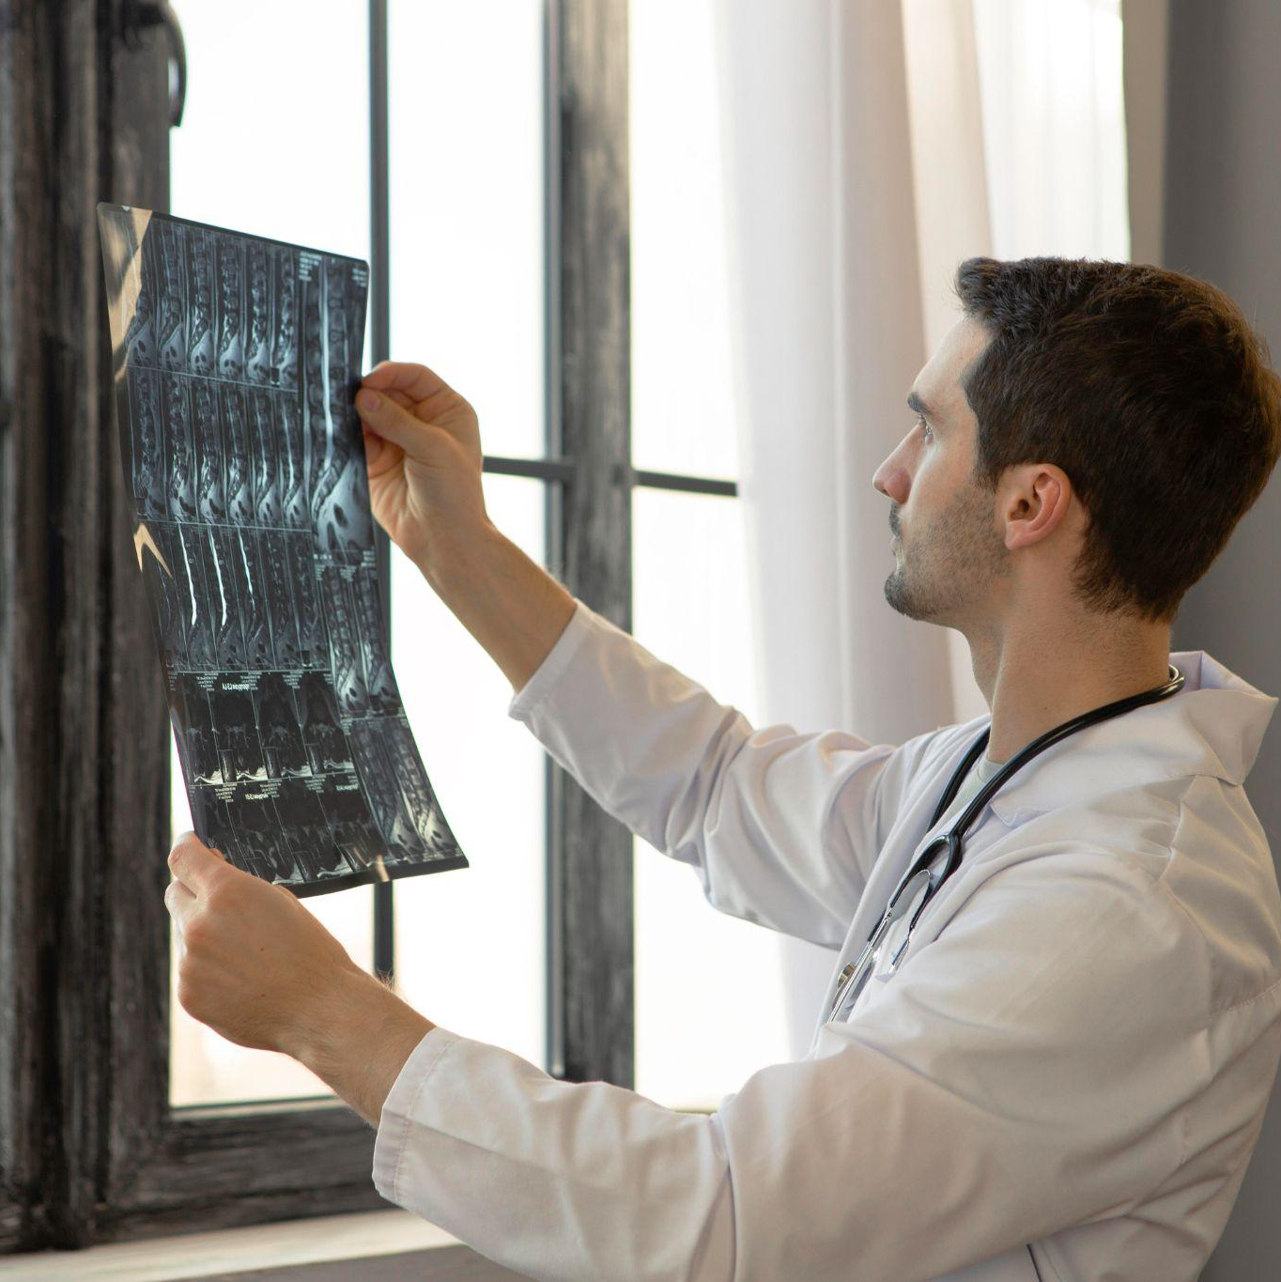

Photo showcase
You can replace the images on the screen with your own work. Just right-click on any of them and select “Replace image”

Slide 16
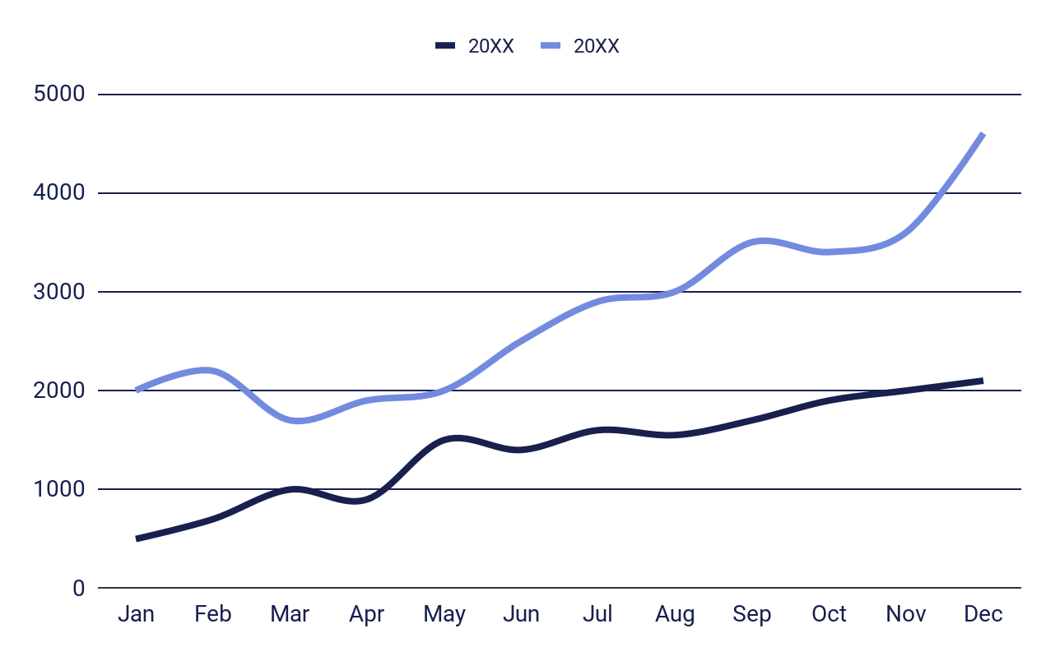
Client experience
Number of patients seen each month
Satisfaction of patients
95%
Mars is red
Would recommend us
75%
Venus is hot
Follow the link in the graph to modify its data and then paste the new one here.

Slide 17



Testimonials
“Neptune is the fourth-largest planet by diameter in the entire Solar System”
Jenna Doe, 25
“Mercury is the closest planet to the Sun and the smallest one in the Solar System”
John James, 36
“Saturn is the ringed planet. It’s composed mostly of hydrogen and helium”
Kate Day, 88

Slide 18


Staff
Dr. Timmy Jimmy
Sarah James
You can replace the image on the screen with your own
You can replace the image on the screen with your own
Role: Medical Director
Role: Director of Nursing
Specialization and expertise:
You can enter a description here
You can enter a description here
You can enter a description here
You can enter a description here
You can enter a description here
Specialization and expertise:
You can enter a description here
You can enter a description here
You can enter a description here
You can enter a description here
You can enter a description here

Slide 19
Thanks
Do you have any questions?
youremail@gmail.com
+55 6788 3838
yourwebsite.com

Slide 20


Alternative resources
Here’s an assortment of alternative resources whose style fits the one of this template:

Slide 21
Resources
Did you like the resources on this template? Get them for free at our other websites:
Photos:
Doctor getting patient ready for ct scan
Front view doctor holding radiography
Female doctor explaining a radiography to patient
Close up on team of health workers
Doctor holding patient hand and a radiography
Medium shot doctor holding radiography
Side view smiley doctor at work
Medium shot female doctor wearing stethoscope
Front view doctor working at clinic
Doctor wearing white coat medium shot
Medium shot veterinarian with stethoscope
Close up on health worker

Slide 22
Fonts & colors used
This presentation has been made using the following fonts:
Sora
(https://fonts.google.com/specimen/Sora)
DM Sans
(https://fonts.google.com/specimen/DM+Sans)
#17204e
#ffffff
#efebe9
#eeeeee
#cad0de
#adb5cf
#92a1dc
#738bde
#a7ccd9

Slide 23
Use our editable graphic resources...
You can easily resize these resources without losing quality. To change the color, just ungroup the resource and click on the object you want to change. Then, click on the paint bucket and select the color you want. Group the resource again when you’re done. You can also look for more infographics on Slidesgo.

Slide 26
JANUARY
FEBRUARY
MARCH
APRIL
MAY
JUNE
PHASE 1
Task 1
Task 2
PHASE 2
Task 1
Task 2
JANUARY
FEBRUARY
MARCH
APRIL
PHASE 1
Task 1
Task 2

Slide 29
...and our sets of editable icons
You can resize these icons without losing quality.
You can change the stroke and fill color; just select the icon and click on the paint bucket/pen.
In Google Slides, you can also use Flaticon’s extension, allowing you to customize and add even more icons.

Slide 30
Educational Icons
Medical Icons

Slide 31
Business Icons
Teamwork Icons

Slide 32
Help & Support Icons
Avatar Icons

Slide 33
Creative Process Icons
Performing Arts Icons

Slide 34
Nature Icons

Slide 35
SEO & Marketing Icons

